Slide 1
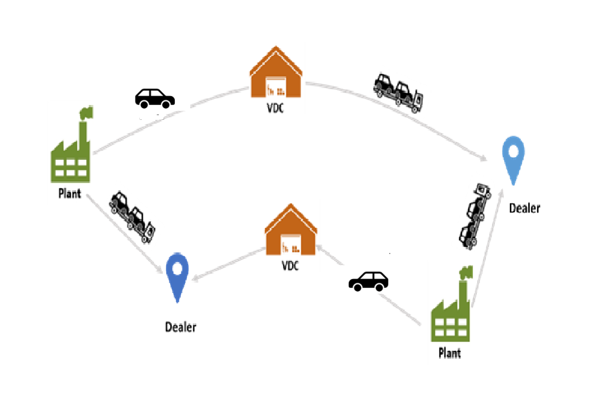

Informs: Redefining Vehicle Delivery with Autonomous Cars
GROUP MEMBERS: LIN, MANALI, KAREEM

Slide 2
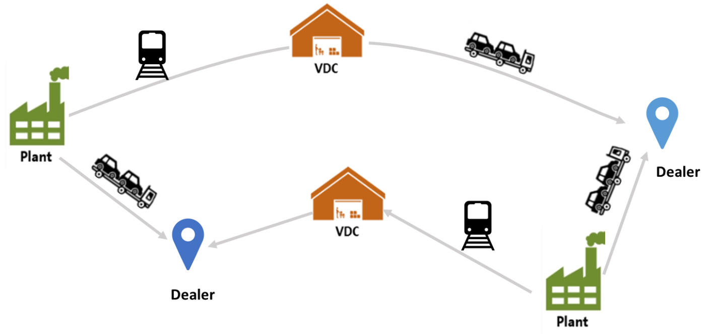
Problem Statement
Determine the lowest cost path from each plant to each dealer, given their locations, existing VDC locations, demand by each dealer, the cost of handling and transportation.
Since the data is huge we are considering sample data which includes
Plant, VDC, Dealers and limited shipping methods.

Slide 3
Approach towards Solution
Understanding the objective, Decision Variables and Constraints
Data Exploration.
Segregating the VDC’s, Plants and Dealers from the given data.
Finding the distance between the plant and dealers in order to compute the cost associated with the transport.
Formulating the Objective Function
Obtain Results: The result will show the total cost of shipping and the number of cars shipped through VDC and shipping method.

Slide 4
Assumptions & Expected Results
Assumptions:
1. 2Plant to 2Dearlers: Plant1:3A,Plant2:FF, Dealer1:21720, Dealer2:21716.
2. Only consider two types of shipping methods:AV and Truck.
Expected Results:
The result will show the total cost of shipping and the number of cars shipped through VDC and shipping method.

Slide 5
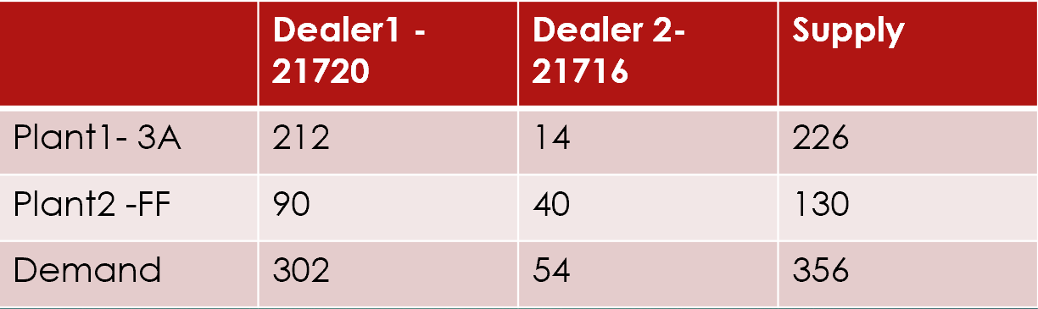
Supply and Demand after data exploration:

Slide 6
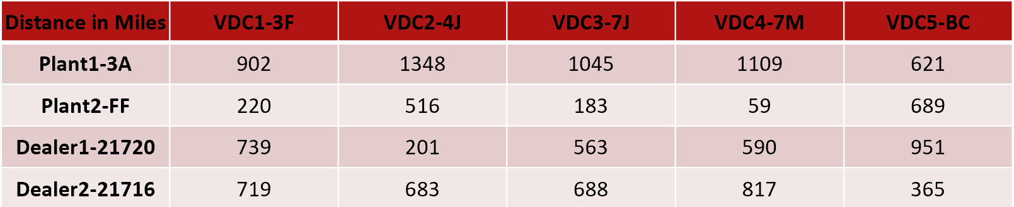
Distance between Dealer and VDC ,Plants and VDC (In miles)
The distance between Dealer1 to VDC1 to 5 are 1190531.8, 324279.7, 906857.7, 950142.2, 1530652.3 (Raw data).
Converted into miles the distance between dealer to VDC 1 to VDC are as follow 739, 201, 563, 590, and 951 miles.

Slide 7
Equation of cost:
Equation of total cost of different shipping method: coefficient of objective function.
AV: Sum of {[(Distance between Plant-VDC)+(Distance between VDC-Dealer)]*0.55 +40}*Qijk.
Truck: Sum of {[(Distance between Plant-VDC) + (Distance between VDC-Dealer)]*0.1*4 +200*0.1 +50}*Tijk.

Slide 8
Equation of cost (cont)
0.55 : shipping cost per car per mile.
40: handle cost per car.
0.1: shipping by truck, 10 cars per load.
4: shipping cost per load per mile.
200: fixed cost per load.
50: handle cost per car.

Slide 9
Objective Function : Minimize the cost.
Lp file
min:
942.55 Q111 + 726.4 T111 + 891.95 Q121 + 689.6 T121 + 924.4 Q131 + 713.2 T131 + 974.45 Q141 + 749.6 T141 + 904.6 Q151 + 698.8 T151 + 567.45 Q211 + 453.6 T211 + 434.35 Q221 + 356.8 T221 + 450.3 Q231 + 368.4 T231 + 396.95 Q241 + 329.6 T241 + 940.35 Q251 + 724.8 T251 + 931.55 Q112 + 718.4 T112 + 1157.05 Q122 + 882.4 T122 + 993.15 Q132 + 763.2 T132 + 1099.3 Q142 + 840.4 T142 + 582.3 Q152 + 464.4 T152 + 556.45 Q212 + 445.6 T212 + 699.45 Q222 + 549.6 T222 + 519.05 Q232 + 418.4 T232 + 521.8 Q242 + 420.4 T242 + 618.05 Q252 + 490.4 T252;

Slide 10

Constraints: Lp file
Demand:
Q111 + T111 + Q121 + T121 + Q131 + T131 + Q141 + T141 + Q151 + T151 = 212;
Q211 + T211 + Q221 + T221 + Q231 + T231 + Q241 + T241 + Q251 + T251 = 90;
Q112 + T112 + Q122 + T122 + Q132 + T132 + Q142 + T142 + Q152 + T152 = 14;
Q212 + T212 + Q222 + T222 + Q232 + T232 + Q242 + T242 + Q252 + T252 = 40;
Integer:
TT111 = 0.1 T111; TT121 = 0.1 T121;
TT131 = 0.1 T131;TT141 = 0.1 T141;
TT151 = 0.1 T151;TT211 = 0.1 T211;
TT221 = 0.1 T221;TT231 = 0.1 T231;
TT241 = 0.1 T241;TT251 = 0.1 T251;
TT112 = 0.1 T112;TT122 = 0.1 T122;
TT132 = 0.1 T132;TT142 = 0.1 T142;
TT152 = 0.1 T152;TT212 = 0.1 T212;
TT222 = 0.1 T222;TT232 = 0.1 T232;
TT242 = 0.1 T242;TT252 = 0.1 T252;
int TT111, TT121, TT131, TT141, TT151, TT211, TT221, TT231, TT241, TT251, TT112, TT122, TT132, TT142, TT152, TT212, TT222, TT232, TT242, TT252;

Slide 11
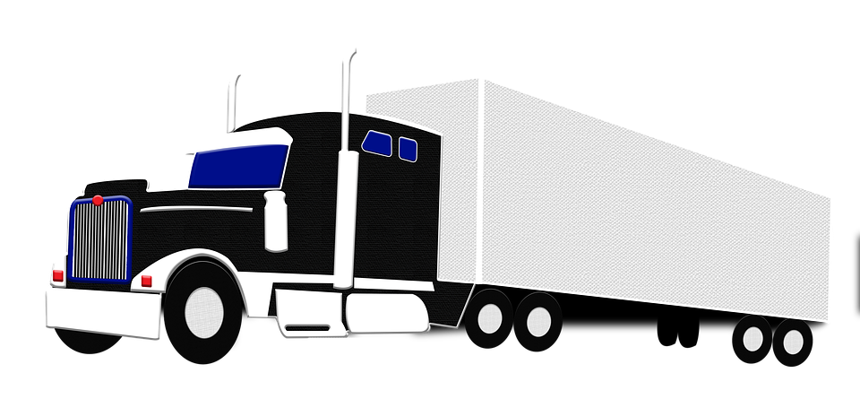
Result
The results shows the best shiping patch of this combination of plants and dealers. Follow the order of variables we can get that: Q121=2, T121=210, T241=90, Q152=4, T152=10, and T232=40.
Also, it shows that the VDC2-4J is the best VDC for shipping between Plant1-3A and Dealer1-21720 (2 by AV, 210 by truck).
The VDC4-7M is the best VDC for shipping between Plant2-FF to Dealer1-21720 (90 by truck).
The VDC5-BC is the best VDC for shipping between Plant1-3A to Dealer2-21716 (4 by AV, 10 by truck).
The VDC3-7J is the best VDC for shipping between Plant2-FF to Dealer2-21716 (40 by truck).

Slide 12
The Third Method: Rail
Cost Equation of Rail:
Sum of {[(Distance between Plant-VDC) + (Distance between VDC-Dealer)]*0.05*3 +2000*0.05 +50}*Rijk
Rijk is the quantity of cars shipped from Plant I through VDC J to Dealer K.
Objective function and constraints should be changed.
0.05 : 20 cars per load
3: 3 dollars per load per mile
2000: fixed cost per load
50: handle cost per car

Slide 13
The Limitation of Time
1. Will affect the number of demand and change the number of constraints. DPiDk.
Q111 + T111 + R111 + Q121 + T121 + R121 + Q131 + T131 + R131 + Q141 + T141 + R141 + Q151 + T151 + R151 = DP1D1;
2. Will affect the shipping method since the shipping with rail is slower than other two methods.
Shipping time equation:
AV&T:[(Distance between Plant-VDC) + (Distance between VDC-Dealer)]/30
Rail:[(Distance between Plant-VDC) + (Distance between VDC-Dealer)]/10

Slide 14
The Capacity of VDC
Will affect the number of cars transported through each VDC and change the number of constraints.
Add the penalty and time limited.
Q111 + T111 + R111 + Q121 + T121 + R121 + Q131 + T131 + R131 + Q141 + T141 + R141 + Q151 + T151 + R151 = DP1D1;
Q111 + T111 + R111 <= C1;

Slide 15
Thank You..

